Slide 1

Welcome to
Android PROBLEMS
by
MD : RAHATUL ISLAM
B.Sc. Engineering Dept. of Ice at PUST.
Gmail ID : rahatul.ice.09.pust@gmail.com
Mobile No : 01790224950

Slide 2
Android Programs
Problem - 1

Slide 3
Android Attribute
cliptopadding=“false”
android:layout_width="wrap_content“
android:layout_height="wrap_content“
android:textStyle="bold“
android:textColor="#ff2“
android:textAppearance="@style/TextAppearance.AppCompat.Large“
android:text="@string/text"

Slide 4
Android Tricks
For Single Line Comments : Press » Ctrl + /
For Multiple Line Comments : Press » Ctrl + Shift + /
For Closing tag : Press » /
For View Group Closing Tag : Press » >
For Change all Variable Name at a time : Press » Shift + F6 + F6
For Create Constructor : Press » Shift + Shift
For Search anything : Press » Shift + Shift
Text Password Integer Code 129,
Text Visible Password Integer Code 145
Number Integer Code 2
Number Password Integer Code 18
Layout Inflater used be covert java file into xml file
Intent used be go to another activity from one activity

Slide 5
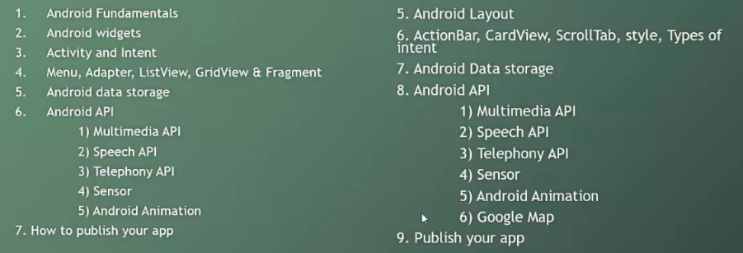
Android Course Plan

Slide 6
Known of Android
What is Android ?
Answer :- Android is a mobile operating system developed by Google, based on the Linux kernel.
Used for smartphones, tablet, Computers, TV.
Owned by American company, Google.

Slide 7
History of Android
Initially developed by Android Inc., Which Google bought in 2005, Android was unveiled in 2007.
Android is the nick name of Andy Rubin given by coworkers.
In 2008, HTC launched the first android mobile.

Slide 8
Features of Android
Phone call service.
Message services.
Screen Capture.
Multiple language supports.
Multitasking.
Supports Wireless communication-> Wi-Fi, Blutooth,3G,4G etc.

Slide 9
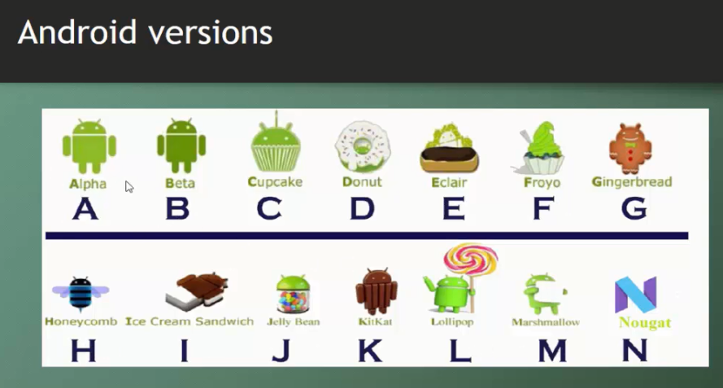
Version of Android

Slide 10
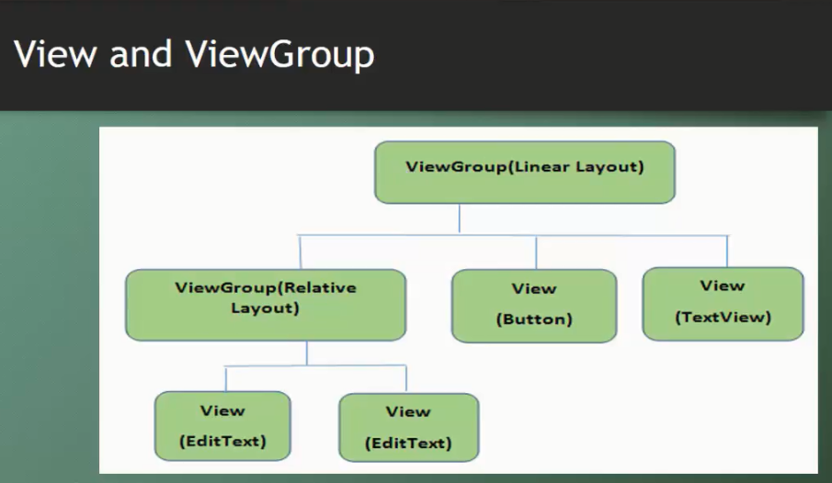
Android View & ViewGroup

Slide 11
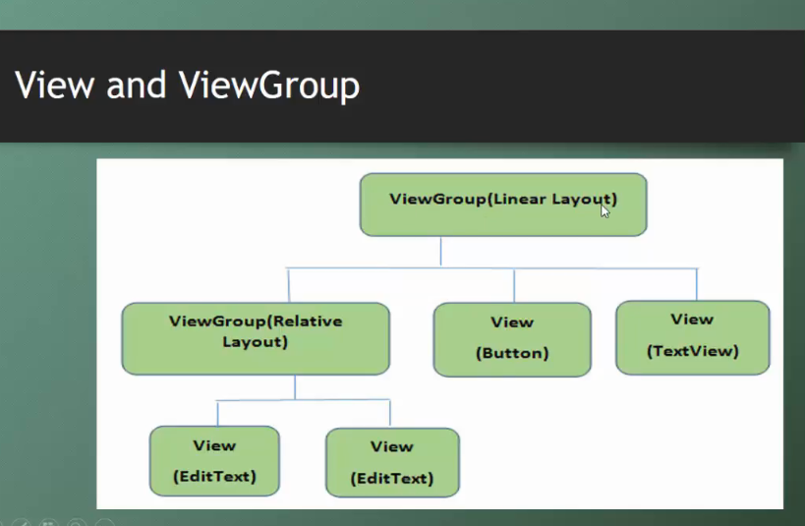
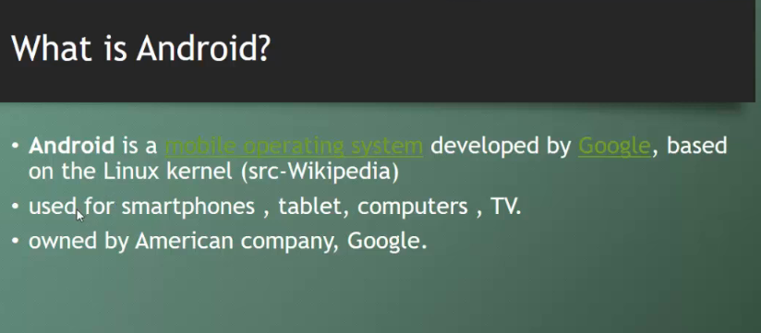
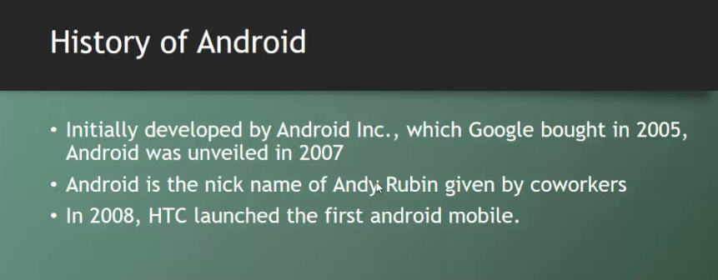
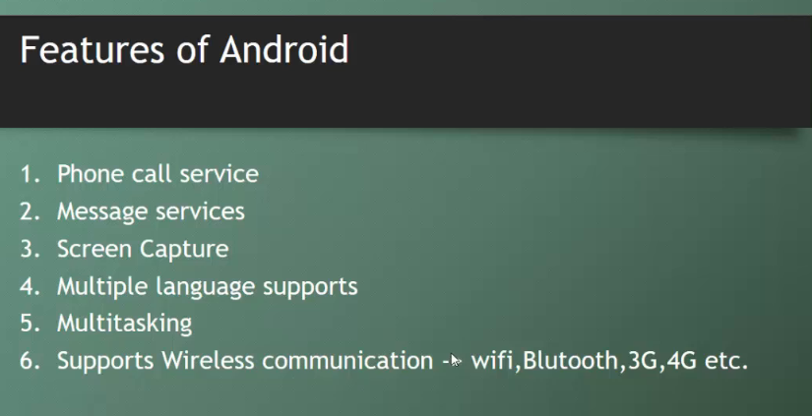
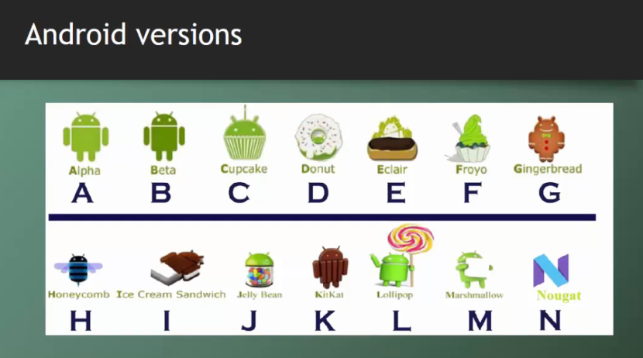
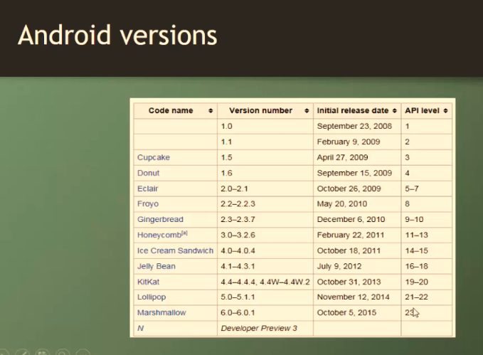
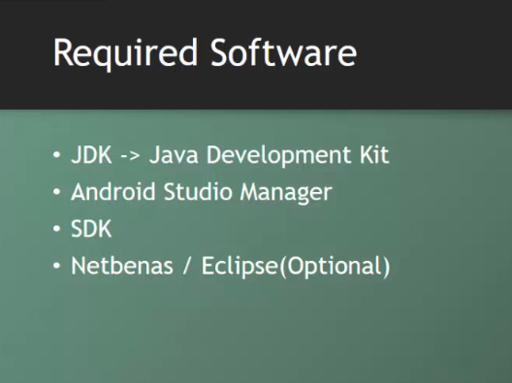
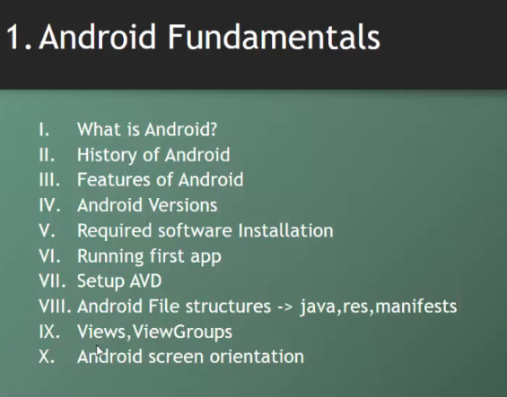
Android Fundamentals

Slide 12
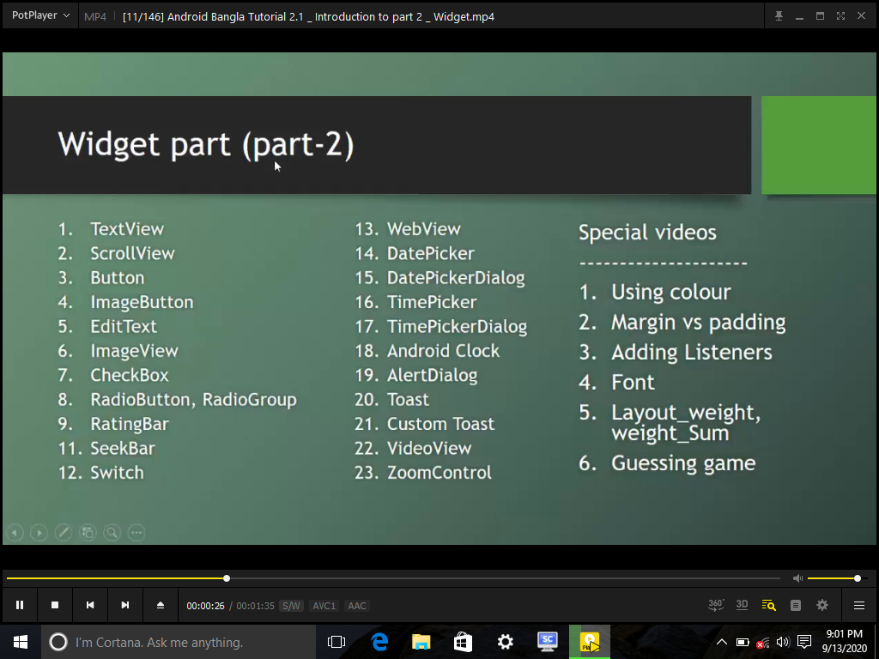
Hint’s Part Two

Slide 13
Android Programs
Problem - 2

Slide 14
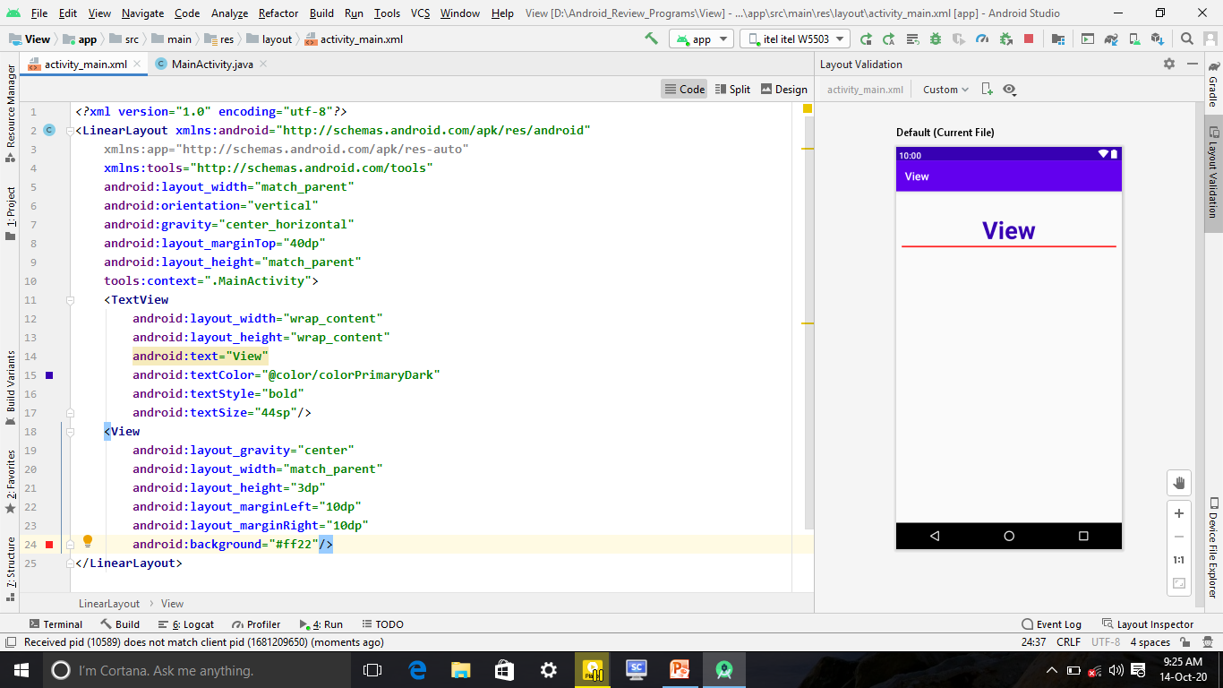
View

Slide 15
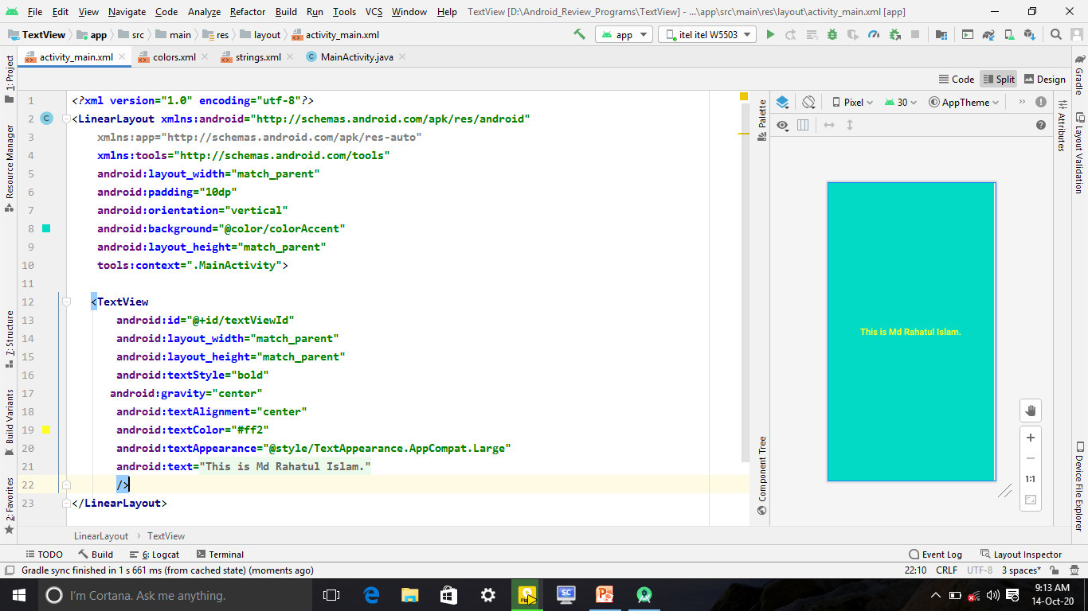
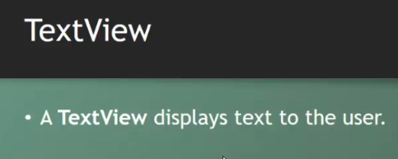
Text View

Slide 16
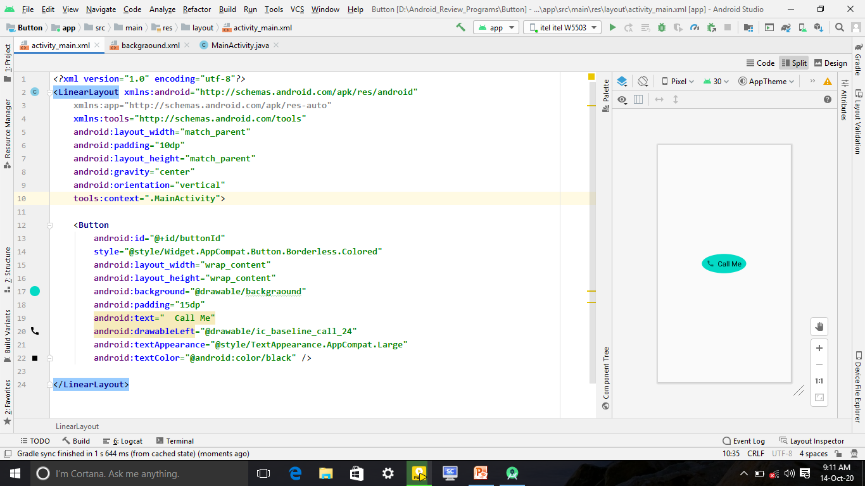
Button & Image with Button
<Button android:id="@+id/buttonId" style="@style/Widget.AppCompat.Button.Borderless.Colored" android:layout_width="wrap_content" android:layout_height="wrap_content" android:background="@drawable/backgraound" android:padding="15dp" android:text=" Call Me" android:drawableLeft="@drawable/ic_baseline_call_24" android:textAppearance="@style/TextAppearance.AppCompat.Large" android:textColor="@android:color/black" />

Slide 17
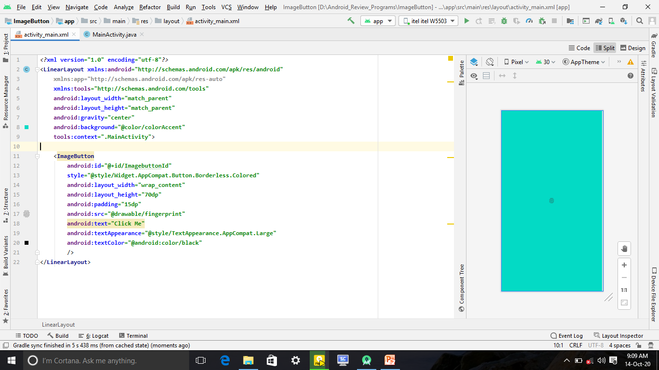
Image Button
<ImageButton android:id="@+id/ImagebuttonId" style="@style/Widget.AppCompat.Button.Borderless.Colored" android:layout_width="wrap_content" android:layout_height="70dp" android:padding="15dp" android:src="@drawable/fingerprint" android:text="Click Me" android:textAppearance="@style/TextAppearance.AppCompat.Large" android:textColor="@android:color/black" />

Slide 18
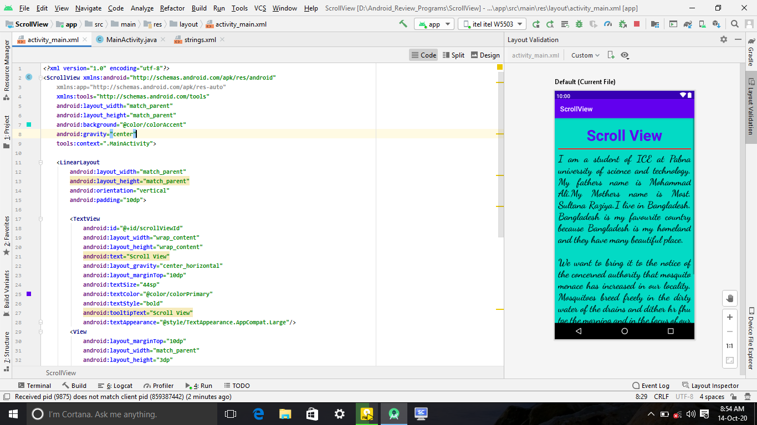
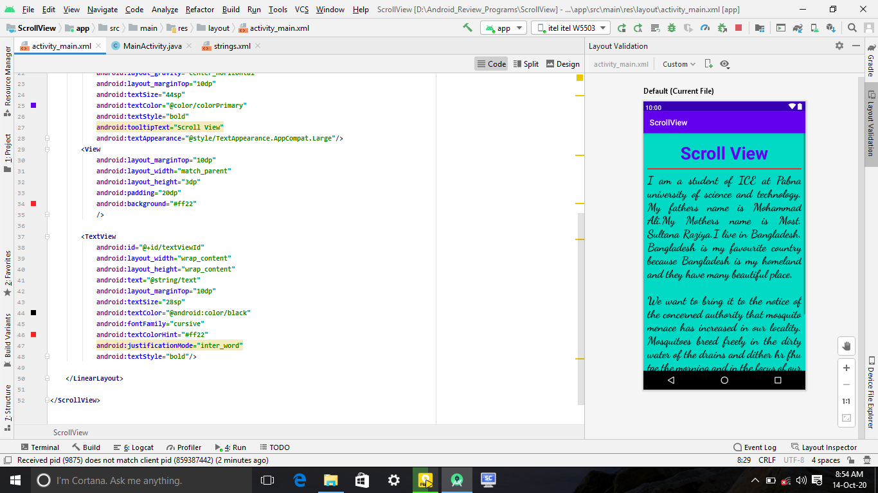
Scroll View
1
2
It’s Contains one View or View Group

Slide 19
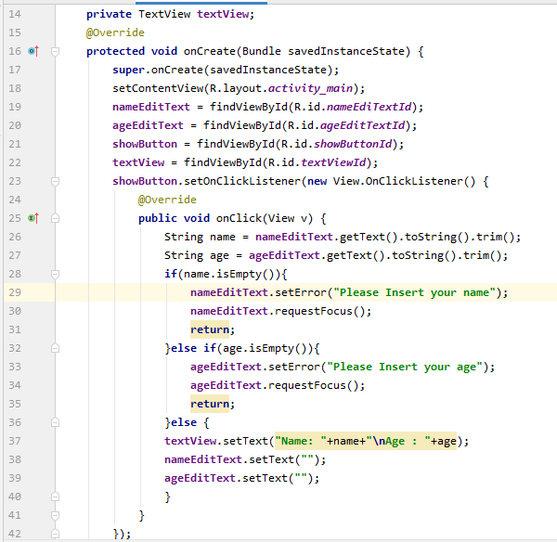
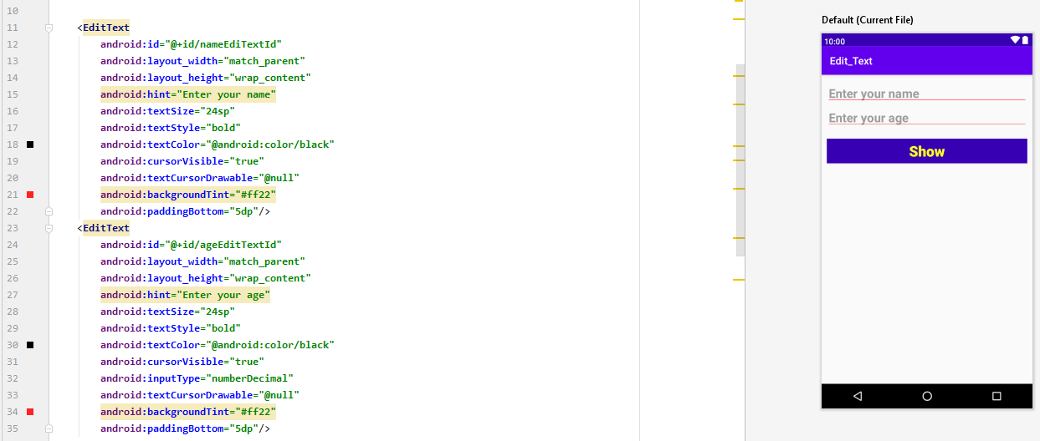
Edit Text
1
2

Slide 20
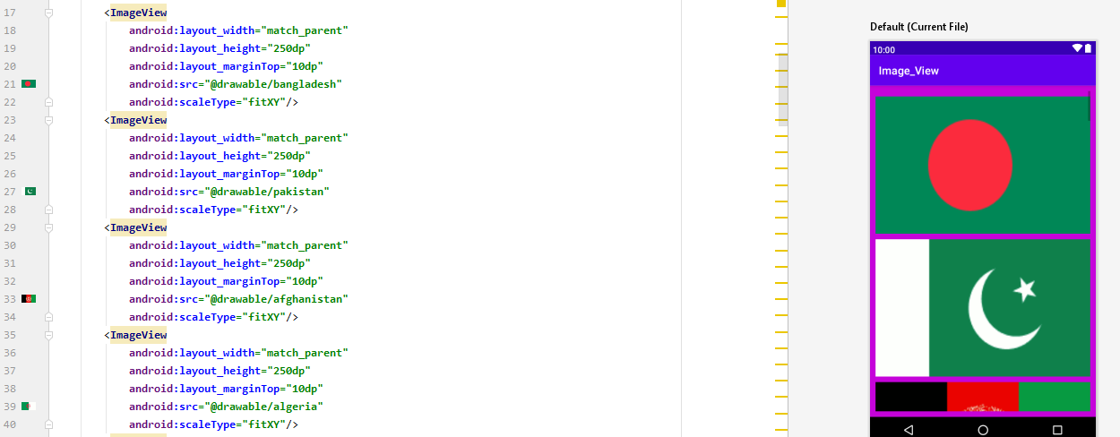
Image View

Slide 21
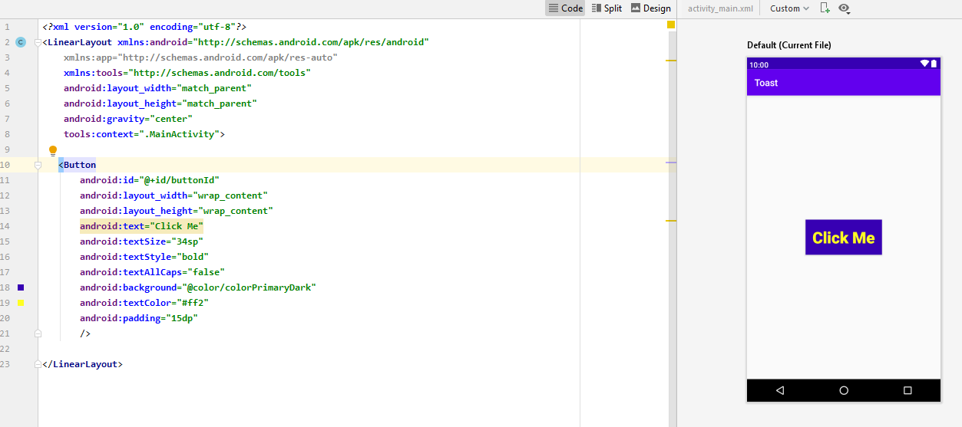
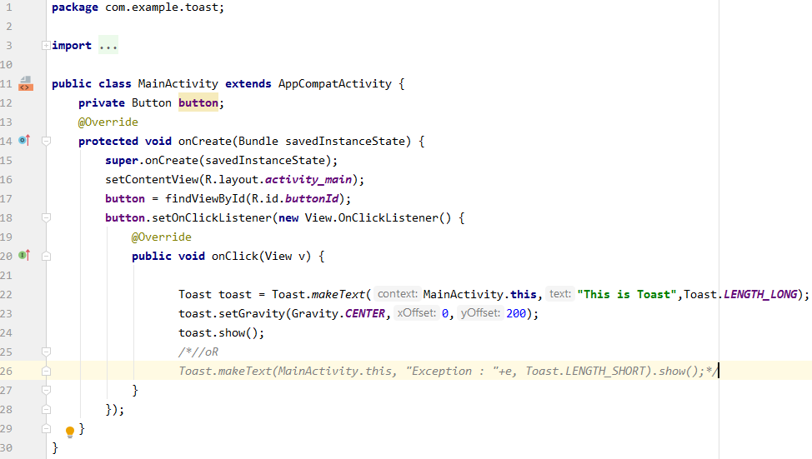
Toast
2
1

Slide 22
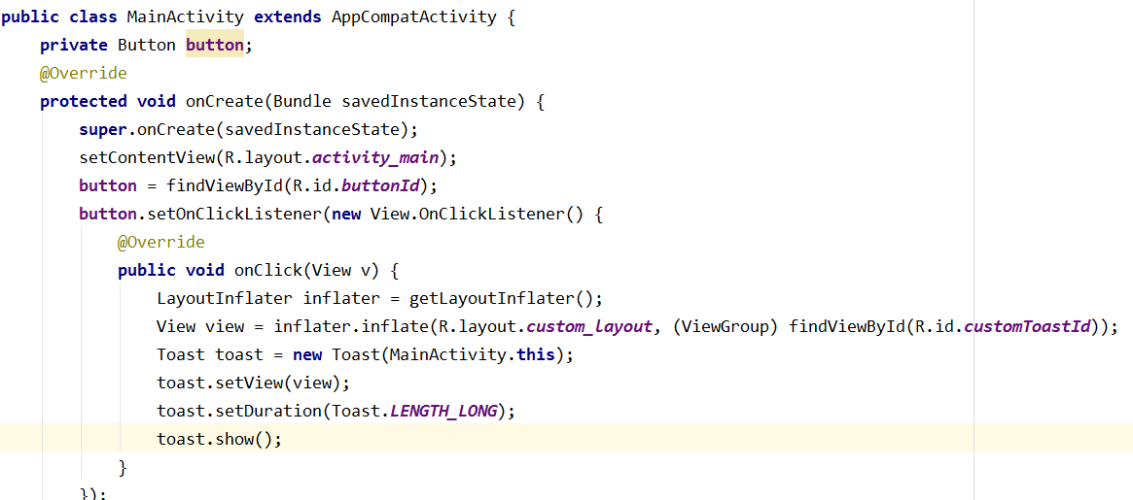
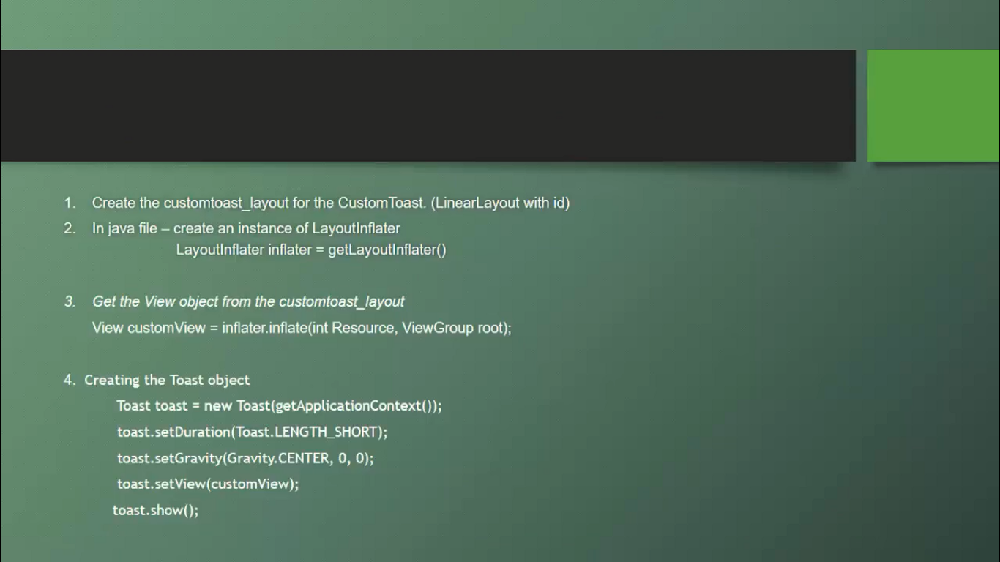
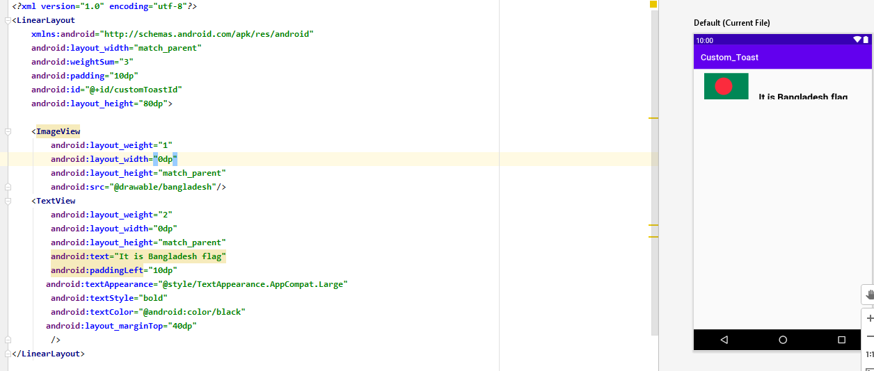
Custom Toast
2
1

Slide 23
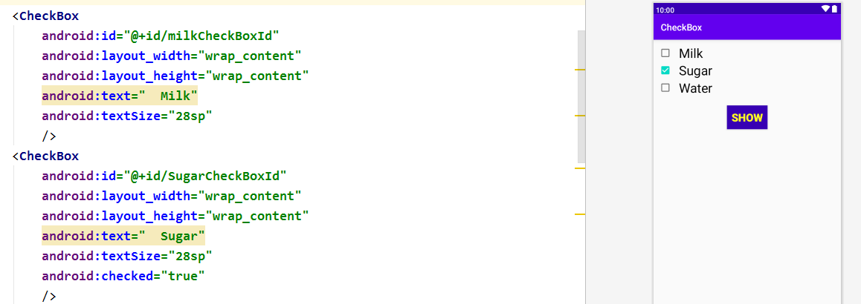
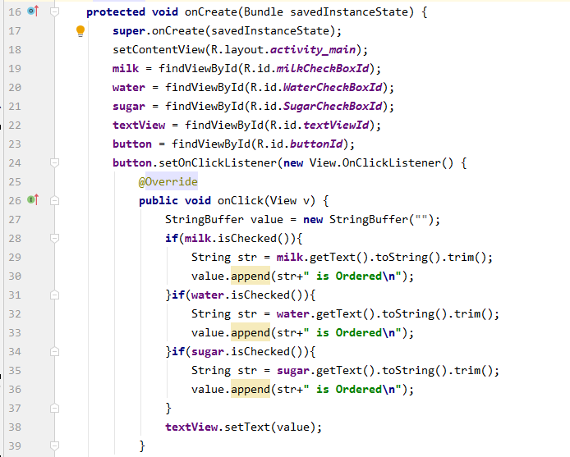
Check Box
1
2

Slide 24
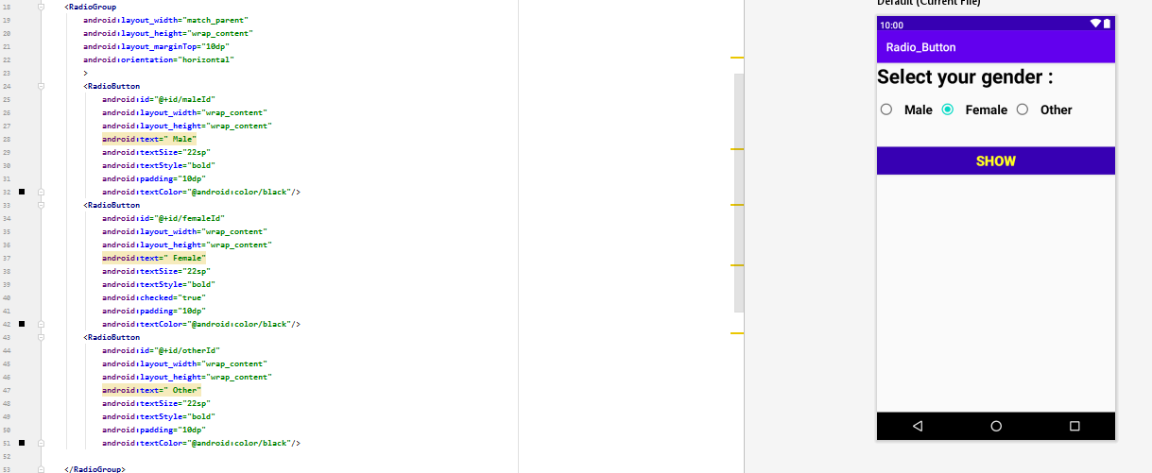
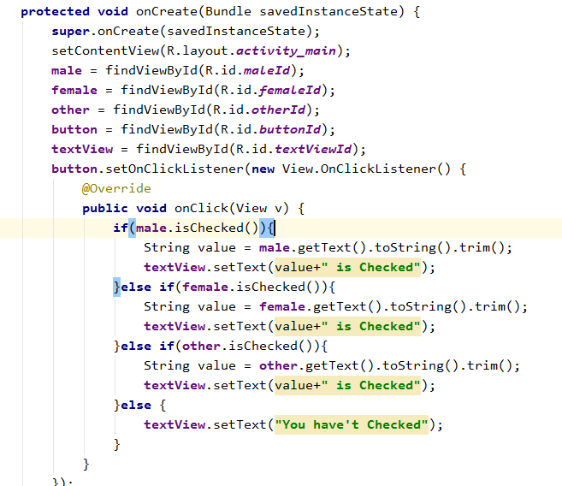
Radio Button
2
1

Slide 25
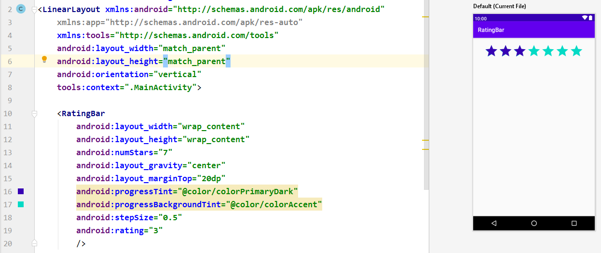
Ratting Bar

Slide 26
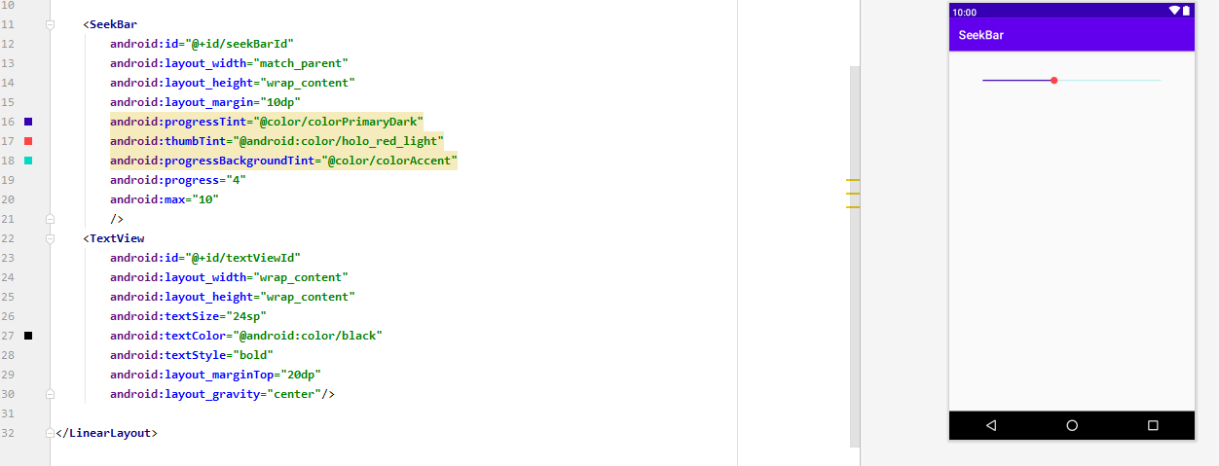
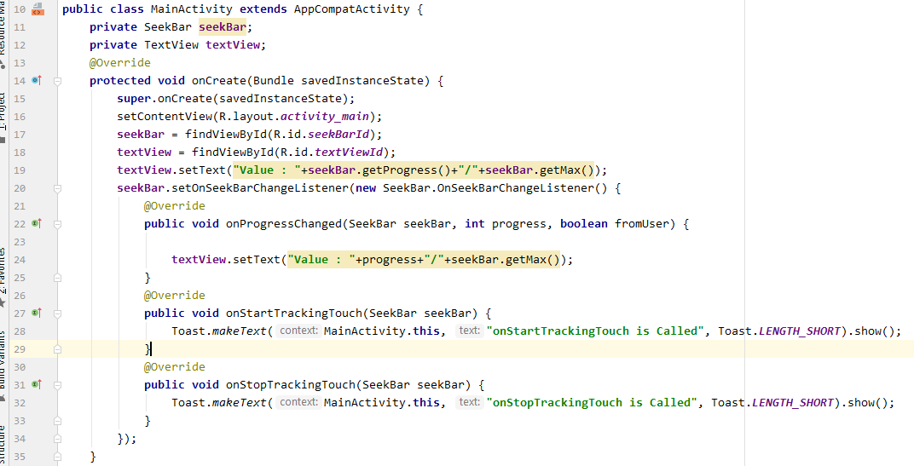
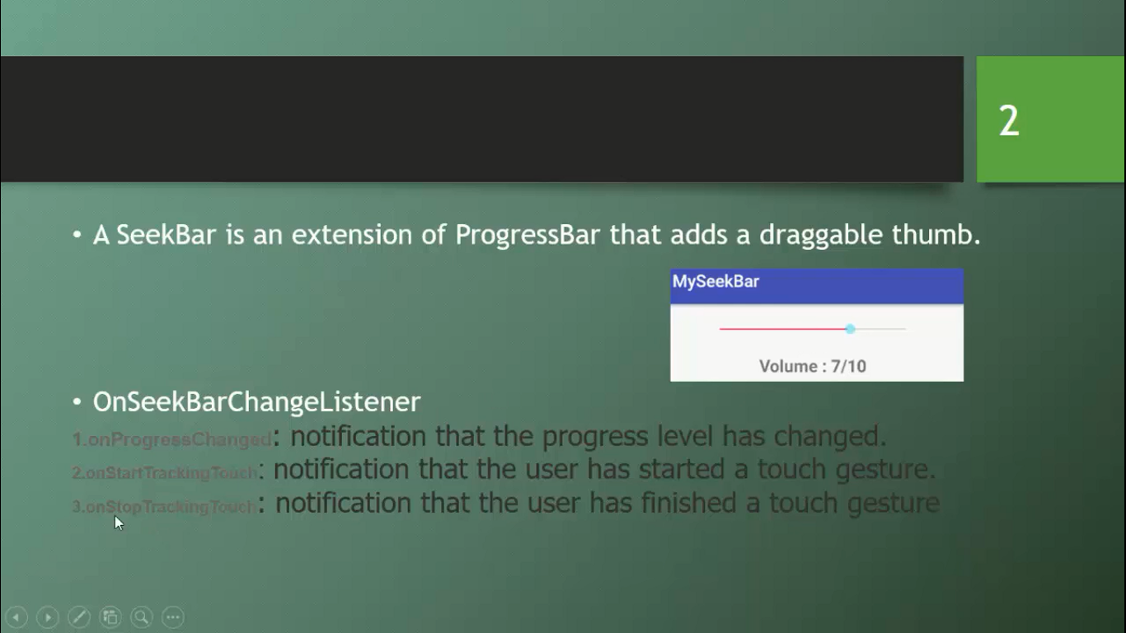
Seek Bar
2
1

Slide 27
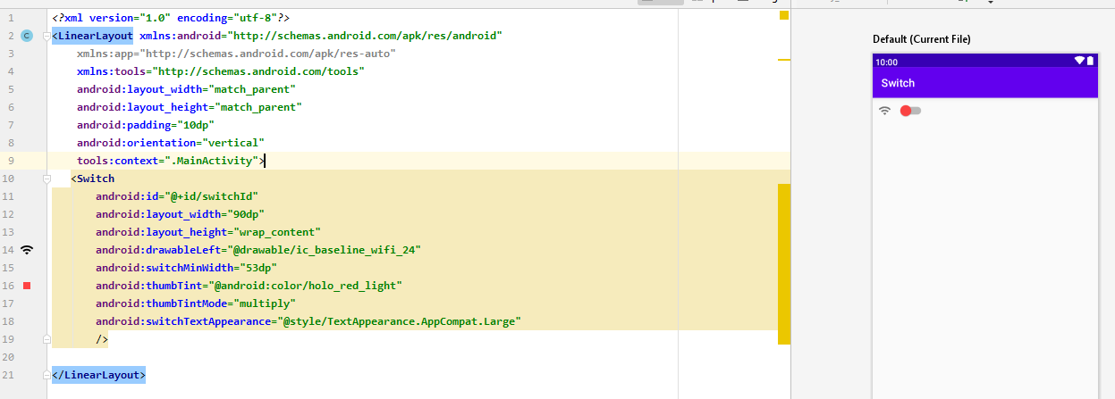
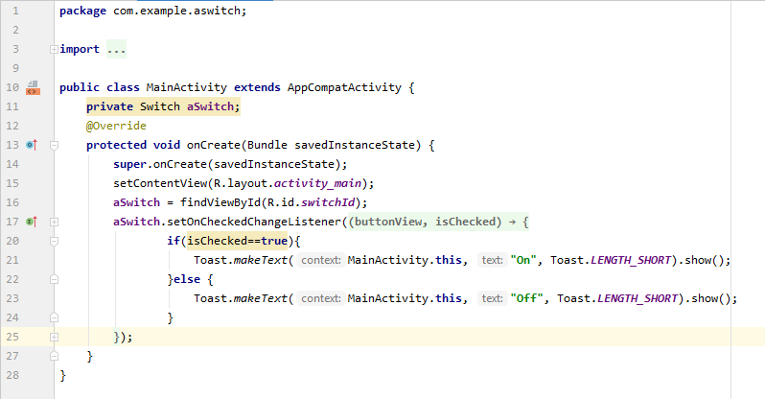
Switch
1
2

Slide 28
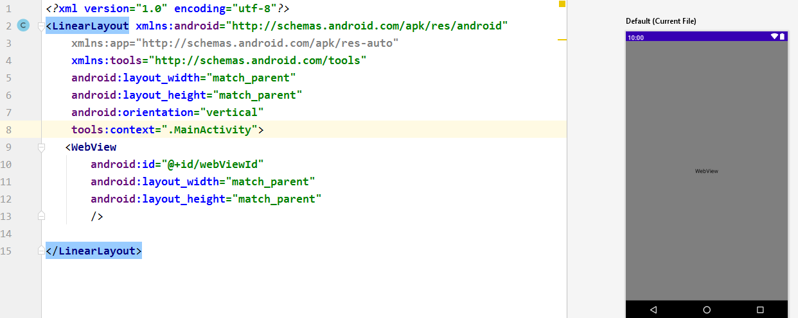
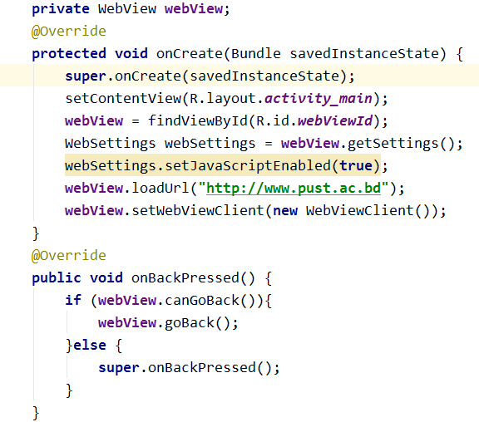
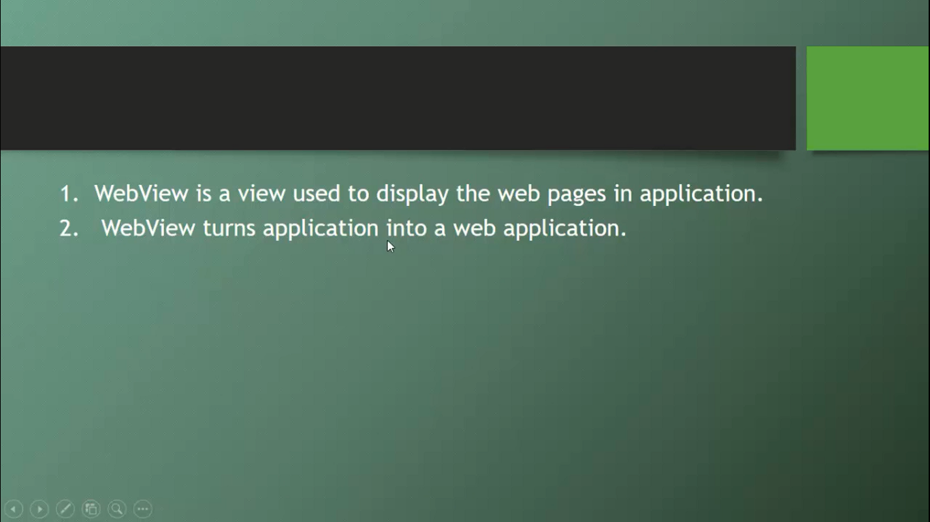
Web View
1
2

Slide 29
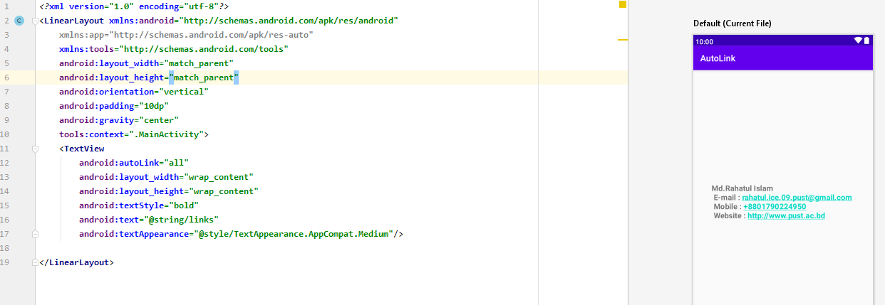
Auto Link

Slide 30
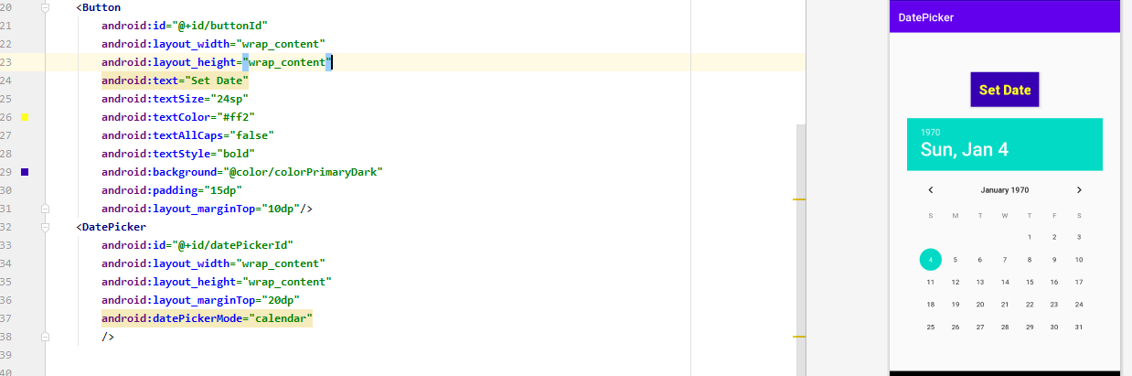
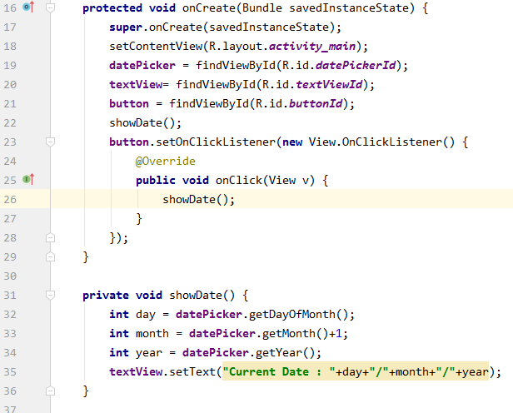
Date Picker
1
2

Slide 31
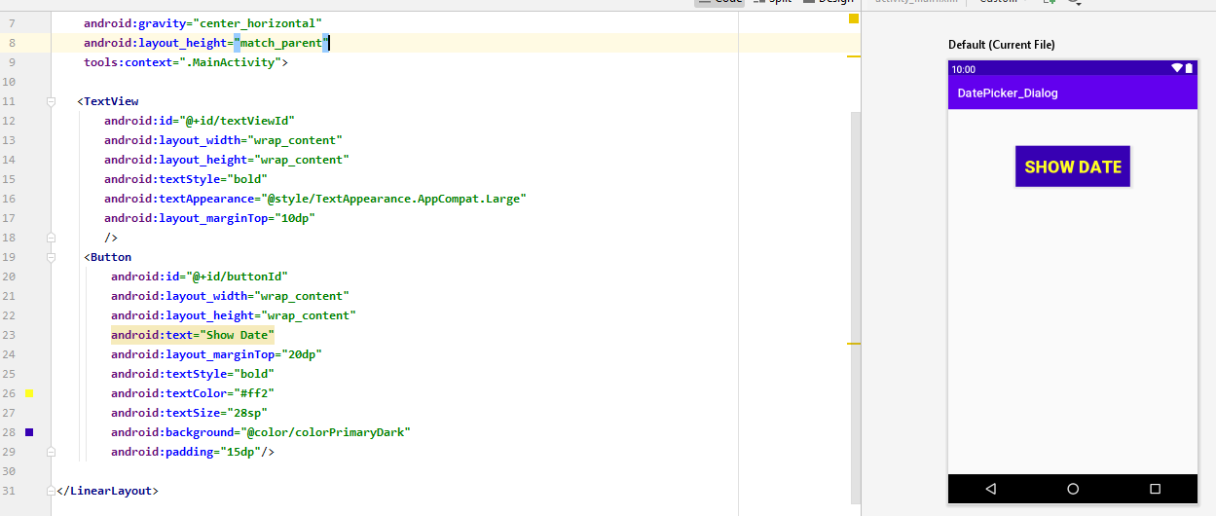
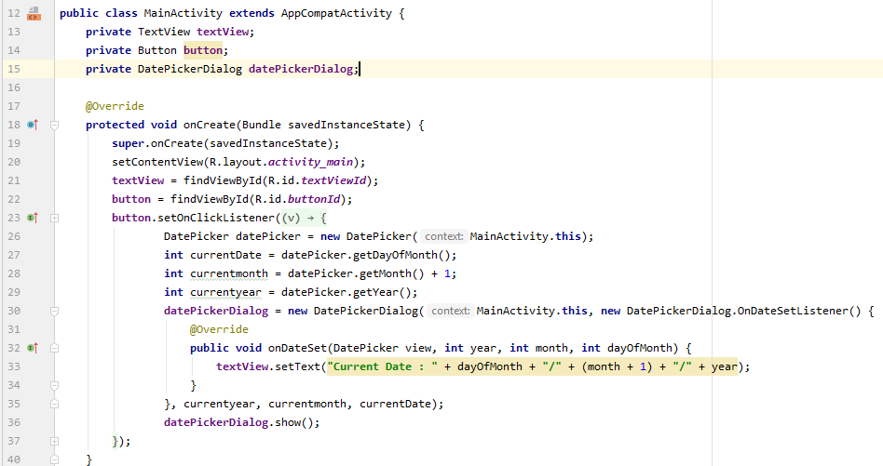
Date Picker Dialog
2
1

Slide 32
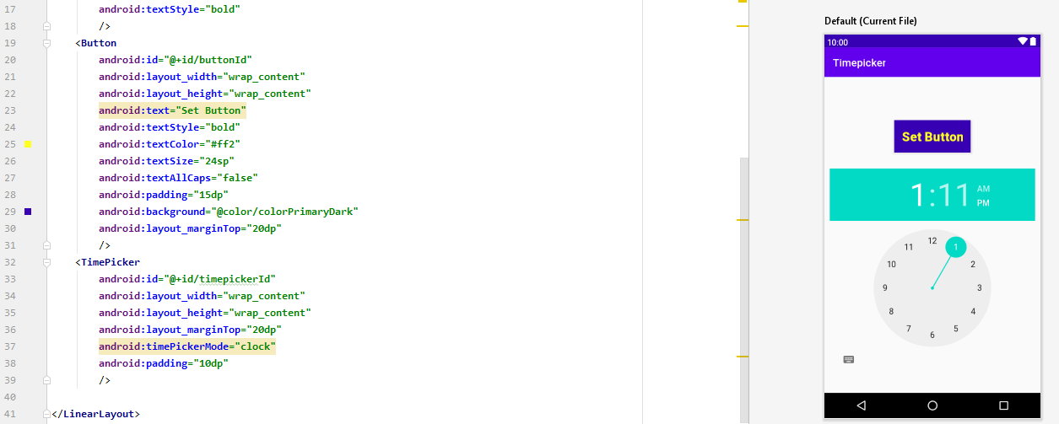
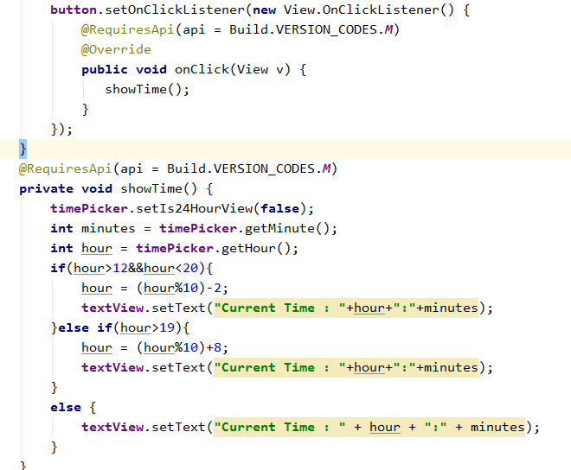
Time Picker
2
1

Slide 33
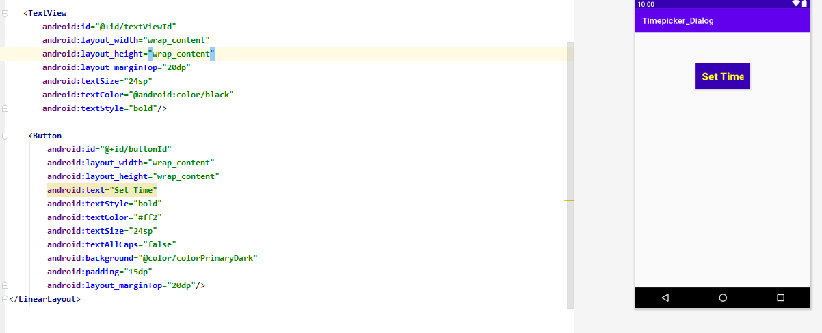
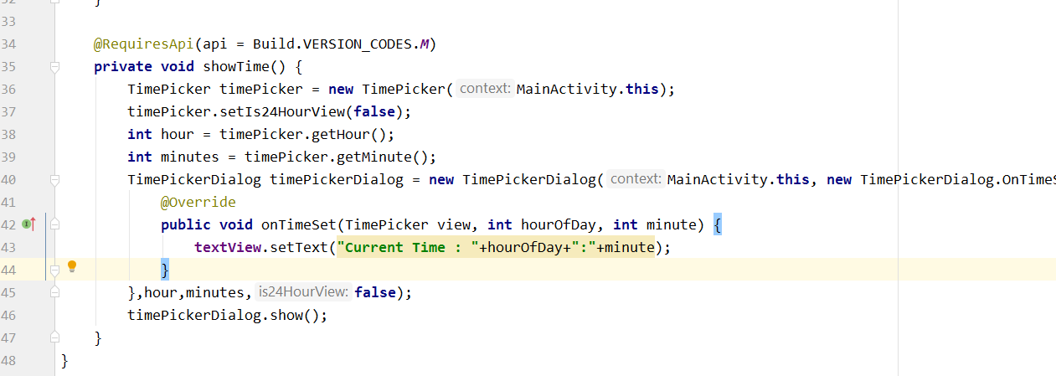
Time Picker Dialog
2
1

Slide 34
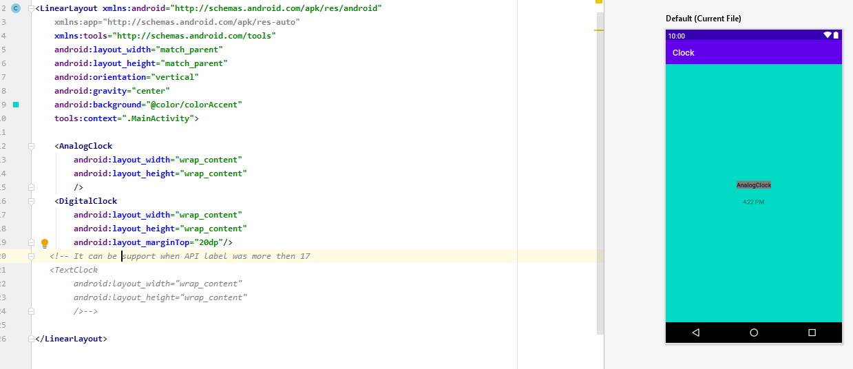
Android Clock
There are three type of Android clock such as-
Analog clock.
Digital clock
Text clock (It can be support when API label is more then 17)

Slide 35

Layout weight & Weight sum

Slide 36


Zoom Controllers
2
1

Slide 37


Video View
2
1

Slide 38
Android Programs
Problem - 3

Slide 39

Hint’s Part-3

Slide 40


Activity Life Cycle

Slide 41




Alert Dialog

Slide 42









Intent
Implicit Intent
3.1
1
Activity for Result 3.2
2.1
2
1
2.2

Slide 43




Country Profile Project
1
4
2
3

Slide 44
Android Programs
Problem - 4

Slide 45

Hint’s Part-4

Slide 46



Adapter

Slide 47




List View With array adapter
2
3
1

Slide 48




List View with Custom adapter
4
3
1
2

Slide 49






Recycler View
2
3.1
4.2
3.2
1
4.1

Slide 50



Search View
2
1
3

Slide 51




Grid View with custom adapter
1
3
4
2

Slide 52






Option Menu
1
2.2
3
4
5
2.1

Slide 53




Spinner
3
4
1
2

Slide 54


Progress Bar
1
2

Slide 55





Splash Screen
1
3
5
4
2

Slide 56




Media Player
1
3
2
4

Slide 57


Auto Complete Text View
Default Layout
2
1

Slide 58







Expandable List View
3
6
7
1
2
4
5

Slide 59





Fragment
2
1
4
5
3
Fragment must be all import type same

Slide 60
Android Programs
Problem - 5

Slide 61

Hint’s Part-5

Slide 62


Relative Layout
2
1

Slide 63




Table Layout
3
2
1
4

Slide 64




Frame Layout
1
3
4
2

Slide 65
Android Programs
Problem - 6

Slide 66

Hint’s Part-6

Slide 67






Set Logo & back Button on Action bar
6
4
1
2
3
5

Slide 68


Applying Style

Slide 69


HTML Content
1
2

Slide 70







Card View
1
2
7
3
4
5
6

Slide 71






Navigation View
5
1
2 Navigation menu item
4
3 Navigation Header layout
Example-2

Slide 72






Tab Layout & View Pager
2
1
3
4
5
6

Slide 73




Custom Background
1
2
3
4

Slide 74

Action Bar Color

Slide 75
Android Programs
Problem - 7

Slide 76







Shared Preference
1
2.1
2.2
3

Slide 77

File Database

Slide 78







SQLite Database
4
1
2
3

Slide 79
Android Reference
www.tutorialpoint.com
www.developer.com
Required Software : JDK, Android Studio Manager, SDK, Netbeans
For Create Custom Background –Software : adobe xd.

Slide 80




